Slide 1

Project Data Lake
Analyzing Dallas Population Trends
By Braum Russell

Slide 2

What is the subject you are analyzing?
This goal of this analysis is to analyze the population trends in Dallas, TX.
According to In 2001, DFW had a total population of 5,354,623, where in 2022 the population was 7,943,685, according to the Federal Reserve Bank of St. Louis.
As a resident in Fort Worth, TX, I have seen the population trends in the Dallas-Fort Worth metroplex increase exponentially, but I am not familiar if the population increase is in Dallas city or in the surrounding suburbs.

Slide 3

What data will you use?
How did you collect the data?
I am using the “Dallas, TX Population by Year” dataset from Neilsberg Research
It includes information about the year and the corresponding population Dallas had.
This data was collected by the US Census.
The data was then pulled by Neilsberg Research where they created a .csv format to view.
I was then allowed to download an instance of the data to be upload and analyzed using Amazon Web Services.

Slide 4
Work Process for project?
Create S3 bucket to hold .csv file of the population trends
Created Crawler in AWS Glue for automatic ETL generation
Used AWS Athena to create a view from querying the table we created in Step 2
Used AWS Quicksight to produce visualizations for Step 3

Slide 5
What tools did you use to accomplish your output?
Tools included that aided with my analysis:
AWS S3
AWS Athena
AWS Glue
AWS Quicksight
R Studio (for quick insights about the data)

Slide 6
What is the story my project is telling?

Slide 7
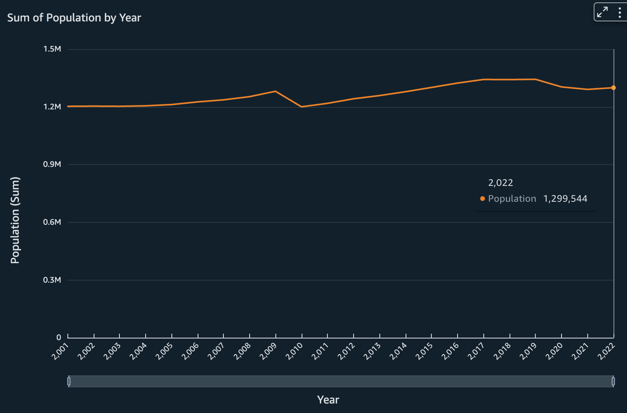
Population Totals Has Not Changed as Much as I Expected
Analyzing the line plot, the minimum population has reached in Dallas was 1,203,699 in 2002, where the maximum population was 1,343,192 in 2019
This change is not as much as expected, but it is seen that Dallas had a steady population increase besides in 3 years
Year vs Total Population(Dallas)

Slide 8
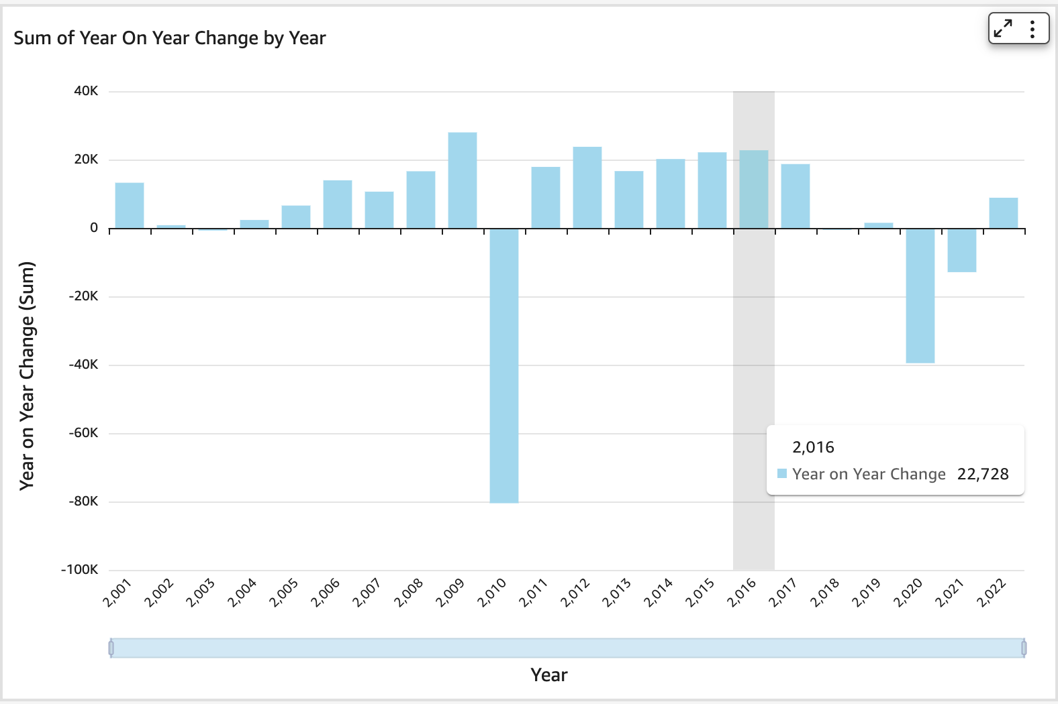
Population Trends Show Increase For Most Years
Due to the increasing metro boom, my original thoughts were that while the years increase, the corresponding population changes each year would increase also.
This chart shows that in the last 3 years, 2022 was the only year Dallas had a positive population growth.
One point that stands out is in the year of 2010, Dallas had 80,000 residents leave the city.
Overall, 19/22 years had positive growth.
Year vs Amount of Population Change each Year

Slide 9
Overall, Dallas is seen to have increases in population in 19/22 years
Thank you, Amazon Web Services, for allowing me to perform this analysis!

Slide 10
References
“Dallas, TX Population by Year - 2023 Statistics, Facts & Trends.” Neilsberg, www.neilsberg.com/insights/dallas-tx-population-by-year/. Accessed 8 Dec. 2023.
“Resident Population in Dallas-Fort Worth-Arlington, TX (MSA).” FRED, 19 May 2023, fred.stlouisfed.org/series/DFWPOP.

